Slide 1

Data Analysis in
By Stephanie Towch
June 2024

Slide 2
Introduction
These slides provide essential tips for mastering the data analysis process in R.
Key Steps:
Importing and Tidying Data: Learn how to load and prepare your dataset.
Imputing Missing Data: Discover methods for handling missing values accurately.
Visualising Data: Use histograms, bar charts, scatterplots, boxplots, and Q-Q plots to explore and present your data.
Descriptive Statistics: Select and view key statistics to gain insights into data distributions.
Data Transformation: Conduct univariate outlier analysis and other transformations to clean your data.
Reliability Analysis: Use Cronbach's Alpha to assess the internal consistency of your scales.
Correlation Matrix: Examine relationships between variables with a correlation data matrix.
Data Modelling: Apply simple linear regression, multiple linear regression, and hierarchical linear regression techniques.
These steps are essential for understanding and interpreting data, ensuring robust analysis and informed decision-making. Let's delve into each stage to uncover valuable insights from our dataset.

Slide 3
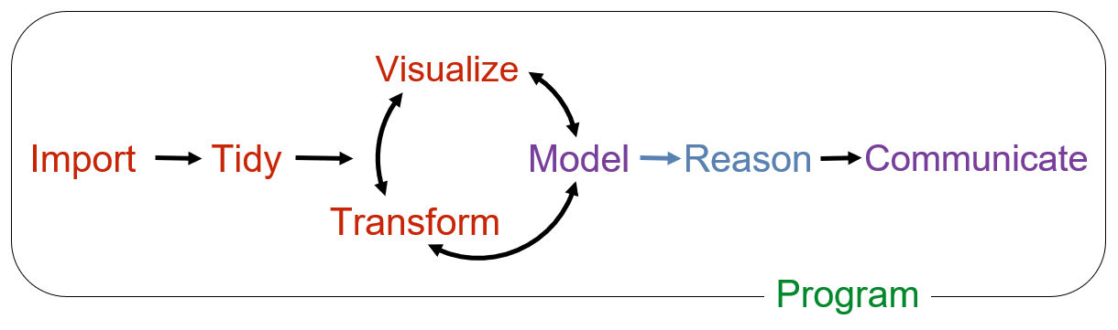
Data Analysis Process Flow in R

Slide 4

Worked Example: Exploring Work Addiction Data
These slides include an accompanying dataset, R script, and user guide that goes through a worked example of all the data analysis stages in R.
The data used in this example is anonymised and was originally collected during my MSc in Organizational Psychology thesis. It has been reworked specifically for regression analysis.
The dataset comprises demographic information along with variables related to:
Work Addiction - The Bergen Work Addiction Scale
Job Satisfaction – The Brief Index of Affective Job Satisfaction
Burnout – The Bergen Burnout Inventory
Psychological Capital – The Psychological Capital Questionnaire
Higher-order construct of hope, optimism, self-efficacy and resilience
Access the Dataset and R Script:
The dataset and accompanying R script can be found on GitHub
This example illustrates the application of various data analysis techniques, providing practical insights into how these methods can be used to analyse real-world data.

Slide 5
Packages
tidyverse (readr, dplyr, ggPlot)
apaTables
ggally
psych
gt
gtsummary

Slide 6
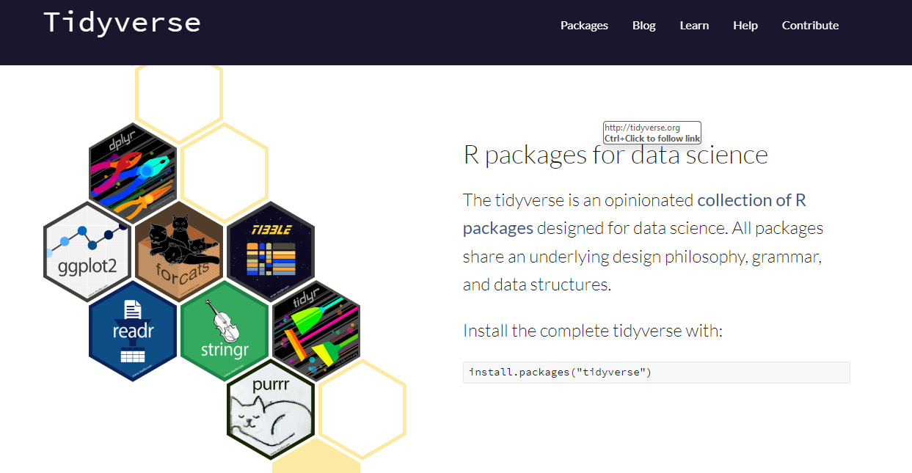
Install the tidyverse package
To find out what packages are included in the tidyverse package use: tidyverse_packages() in the command line
or go to https://www.tidyverse.org/ for more information.
To load the tidyverse package:
library(tidyverse).
Click on cheat sheet to discover guides on all the functionality.
Use the readr package within tidyverse to import your data.

Slide 7
Tidy - Imputing missing values
There are various techniques to impute missing values and you can do this manually if it is simple.
This website shows various methods for imputing missing values.
These include simple techniques such as constant, mean, and median imputations that do not require any R coding.
Alternatively, the MICE (Multivariate Imputation via Chained Equations) package has many univariate imputation methods including ppm (predictive mean matching), cart (classification and regression trees or laso.norm (lasso linear regression).
Another option is the MissForest package, which uses a random forest algorithm (non-parametric imputation method).

Slide 8
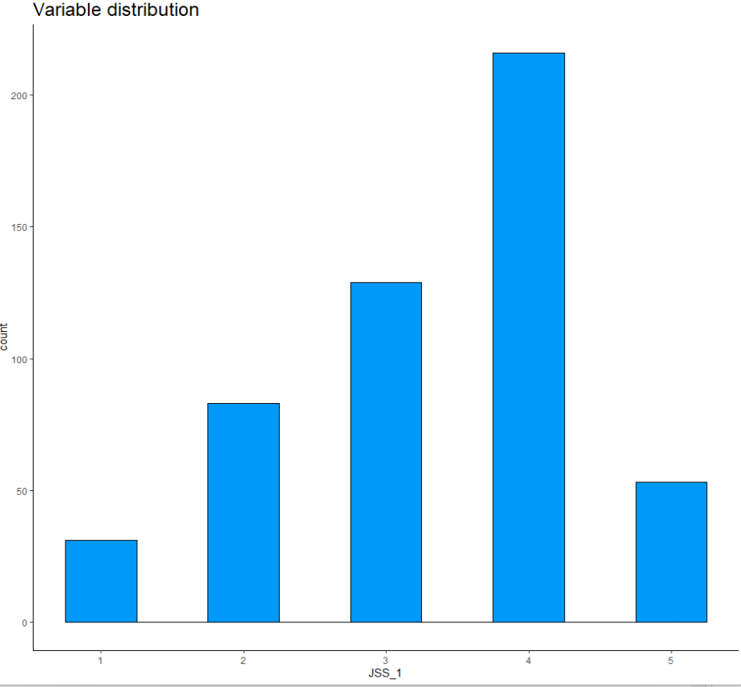
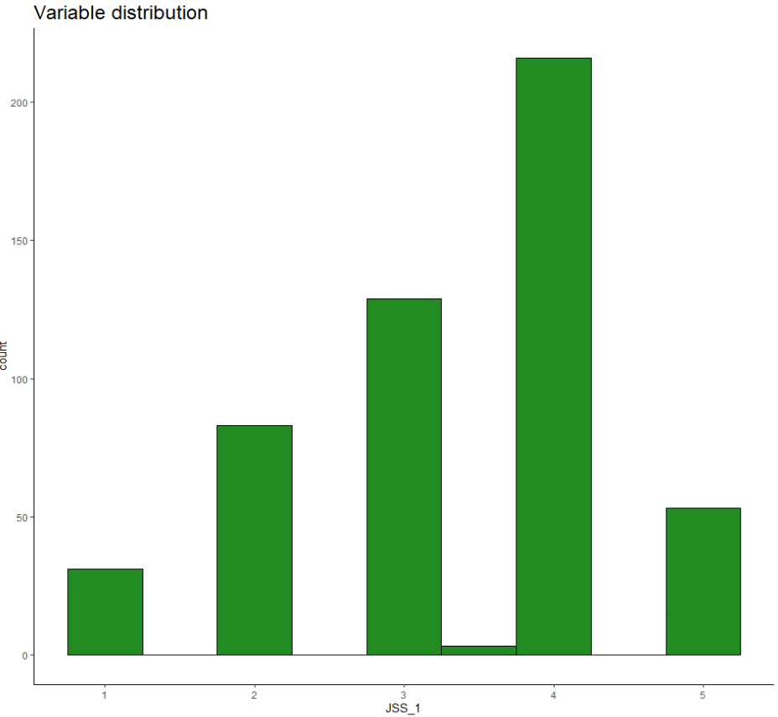
Visualise - Before and after imputing missing values - Histograms using ggplot from the tidyverse package
Original distribution
Imputing mean values of Job Satisfaction Scale

Slide 9
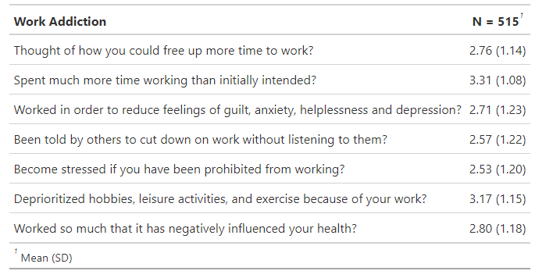
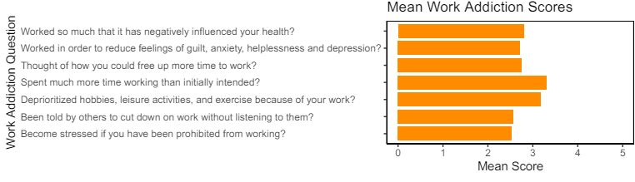
Visualise – Summary table and bar charts
The gtsummary package and ggplot from the tidyverse package can be used to visualise the data for each scale to create summary tables and bar charts.

Slide 10
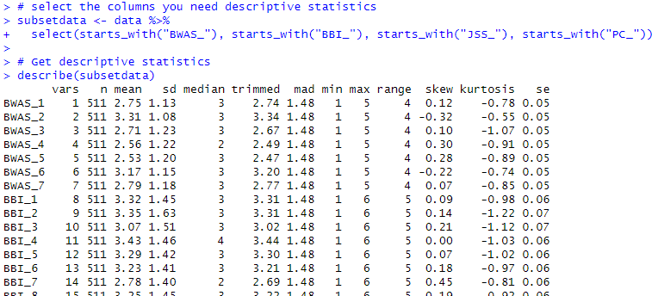
View Descriptive Statistics
The describe function in the Psych package can provide a summary table of the n, mean, standard deviation, median, min, max, range, skew, kurtosis and standard error in a dataset.
To extract specific columns to run descriptive statistics that start with a prefix string, the dpylr package within tidyverse package in R can be used with the select() and starts_with() functions. For more information on transforming your data, see the dpyler cheat sheet.
To save the descriptive statistics table as a .csv file, use the write_csv() function from the readr package within the tidyverse package.

Slide 11
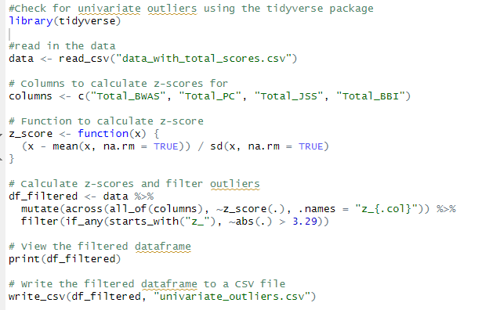
Transform - Univariate Outlier Analysis
Univariate outliers can be identified in R using the tidyverse package and standardised scores with Field’s (2013) procedure (±3.29 standard deviations from the observed variable z-scores, a threshold of around 99.9% of normally distributed observed variable z-scores).

Slide 12
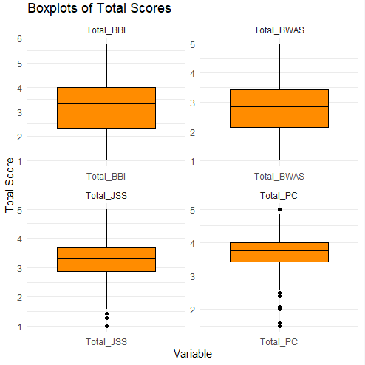
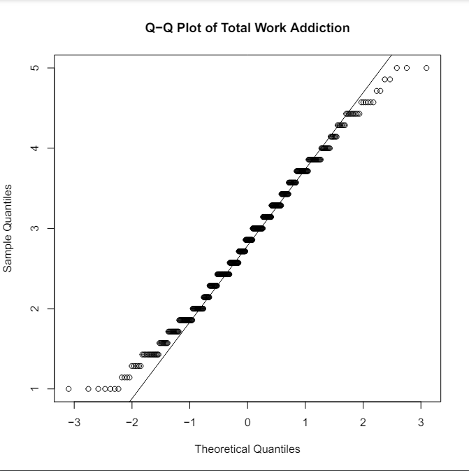
Visualise the data – Boxplots and Q-Q Plots
Visualise the data using ggplot from the tidyverse package to create boxplots and Q-Q Plots to check for normal distributions

Slide 13
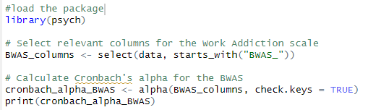

Internal Consistency Reliability in R
Calculate the Cronbach alpha for each scale to assess the internal reliability consistency using the psych package in R
The general rule of thumb is that a Cronbach’s alpha of .70 and above is good, .80 and above is better, and .90 and above is best.
The output from R shows the raw_alpha and std.alpha as 0.86 for the Bergen Work Addiction Scale (BWAS) indicating good internal consistency.

Slide 14
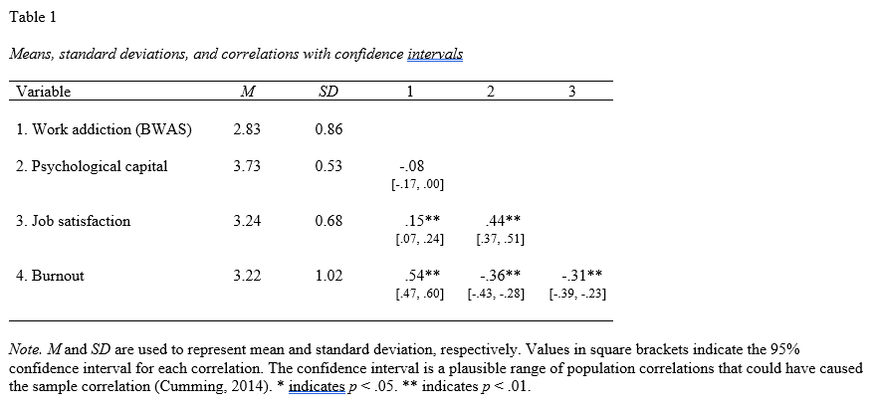
Visualise - Correlation Data Matrix
Visualise correlation data using the apaTables package in R

Slide 15
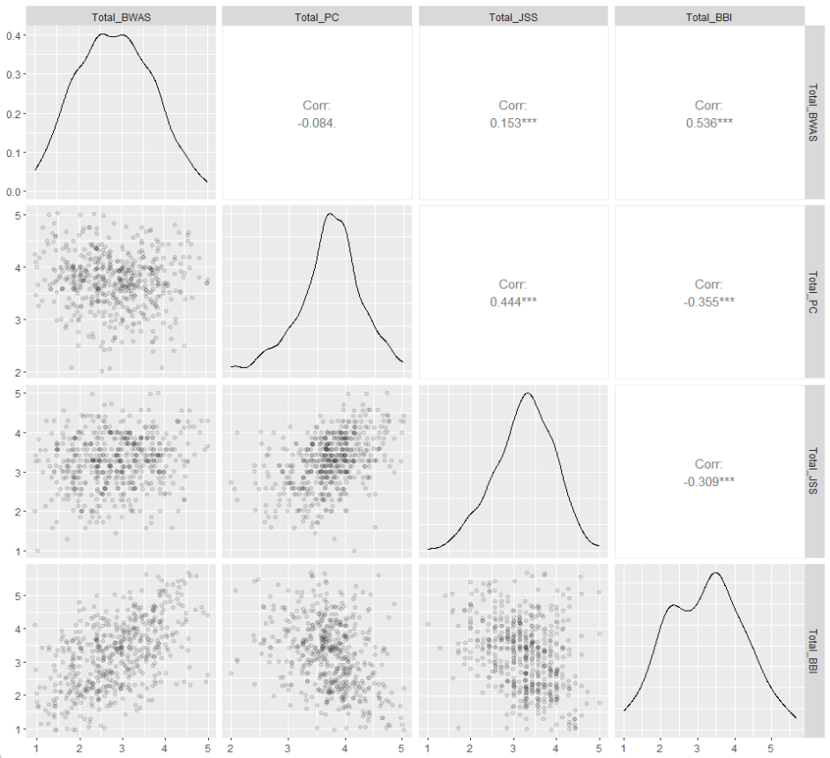
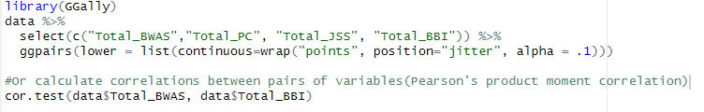
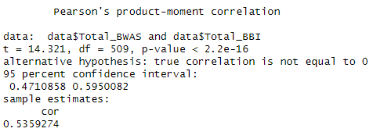
Visualise - Correlation Data Matrix
Visualise correlation data using the GGally package in R or calculate correlations (Pearson’s product-moment correlation between pairs of variables using cor.test() from the psych package.

Slide 16
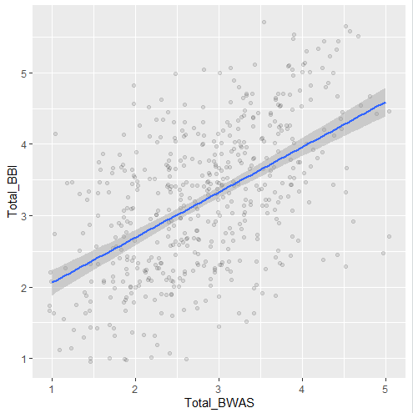
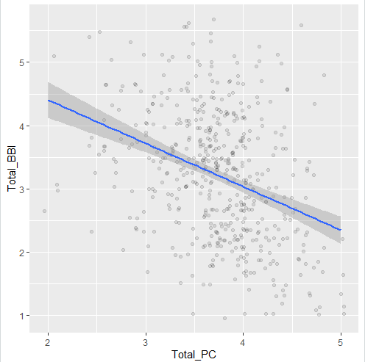
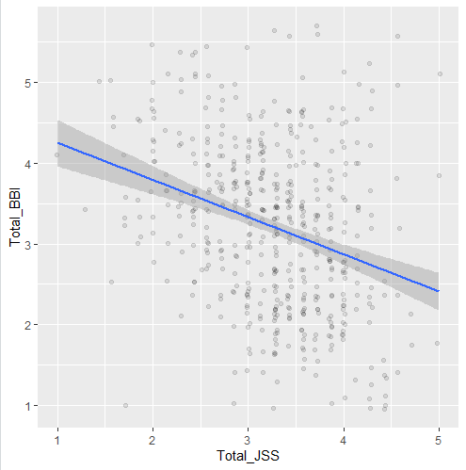
Visualise – Scatterplots – Linear Relationship
Visualise the data using ggplot from the tidyverse package to create scatterplots between the independent and dependent variables to check for a linear relationship that is an assumption of regression analysis.

Slide 17

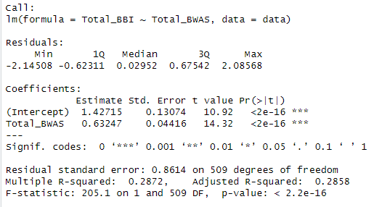
Model - Simple Linear Regression
Estimating a simple linear regression model using the lm function in Base R between one independent variable and one dependent variable.
APA Style Reporting:
A simple linear regression analysis was conducted to evaluate the extent to which Work Addiction scores (Total_BWAS) could predict Burnout scores (Total_BBI). A significant regression equation was found (F(1,509) = 205.1, p < .001), with an R² of .29, indicating that Work Addiction scores explained approximately 29% of the variance in Burnout scores.
Formula: Total_BBI = 1.427 + 0.632 * Total_BWAS
Both the intercept (1.427, p < .001) and the slope (0.632, p < .001) were statistically significant.
The predicted burnout score increased by approximately 0.632 percentage points for each one-point increase in work addiction scores.
The model fits the data significantly well, as indicated by the high F-statistic and low p-value for the model overall.

Slide 18
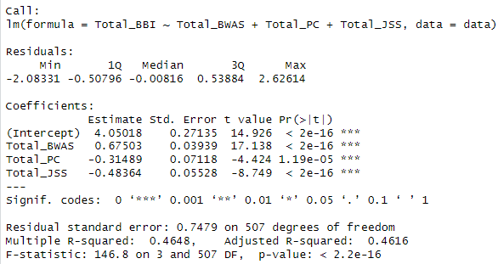
Model - Multiple Linear Regression
Estimating a multiple linear regression model uses the same lm function in Base R between multiple independent variables and one dependent variable.

Slide 19
Communicate – Multiple Linear Regression Results (APA style)
A multiple linear regression analysis was conducted to evaluate the extent to which work addiction (Total_BWAS), psychological capital (Total_PC) and job satisfaction (Total_JSS) could predict Burnout (Total_BBI). A significant regression equation was found (F(3, 507) = 146.8, p < .001), with an R² of .46, indicating that work Addiction, psychological capital and job satisfaction explained approximately 46% of the variance in Burnout scores.
Formula: Total_BBI = 4.050 + 0.675 × Total_BWAS − 0.315 × Total_PC − 0.484 × Total_JSS
Both the intercept (4.050, p < .001) and the coefficients for Total_BWAS (0.675, p < .001), Total_PC (-0.315, p < .001), and Total_JSS (-0.484, p < .001) were statistically significant.
The results indicate that for every one-unit increase in work addiction scores (Total_BWAS), the predicted burnout score (Total_BBI) increases by approximately 0.675 points. Conversely, an increase in psychological capital (Total_PC) and job satisfaction (Total_JSS) is associated with decreases of approximately 0.315 and 0.484 points in burnout scores, respectively.
The model provided a good fit to the data, as demonstrated by the high F-statistic and low p-value, underscoring the significance of work addiction, psychological capital, and job satisfaction in predicting burnout.

Slide 20
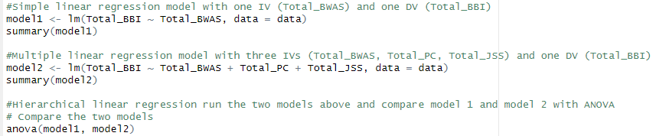
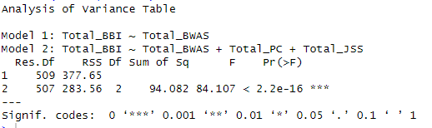
Model - Hierarchal Linear Regression
Create simple or multiple linear regression models in R using the lm function in base are and use ANOVA to compare models.
Example – compares the simple linear model (model 1) with the multiple regression model (model 2)
ANOVA Output results in R

Slide 21
Communicate - Hierarchal Linear Regression (APA style)
A hierarchical linear regression analysis was conducted to compare two linear regression models predicting burnout scores (Total_BBI). Model 1 included only work addiction (Total_BWAS) as a predictor, while Model 2 added psychological capital (Total_PC) and job satisfaction (Total_JSS) as additional predictors.
The analysis of variance (ANOVA) results indicated a significant improvement in Model 2 over Model 1 in predicting burnout scores, ΔF(2, 507) = 84.11, p < .001. Model 2 (R² = .465) explained significantly more variance in burnout scores compared to Model 1 (R² = .426), as evidenced by a reduction in residual sum of squares (RSS) from 377.65 to 283.56, respectively.

Slide 22
Cheat sheets
RStudio has a range of Cheat Sheets for further functionality https://posit.co/resources/cheatsheets/

Slide 23
References
Field, A. (2013). Discovering statistics using IBM SPSS statistics (4th ed.). SAGE Publications.

